Slide 1

WIS and WIGOS
Enrico Fucile
Chief Data Representation, Metadata and Monitoring Division

Slide 2
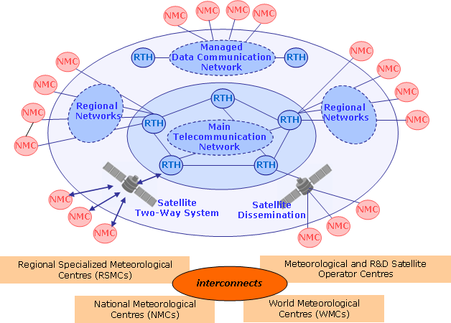
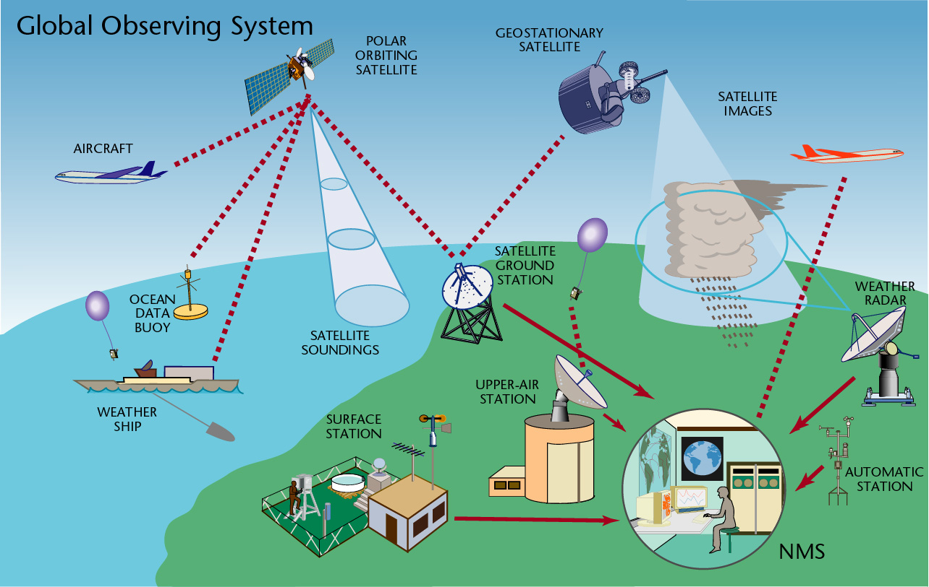
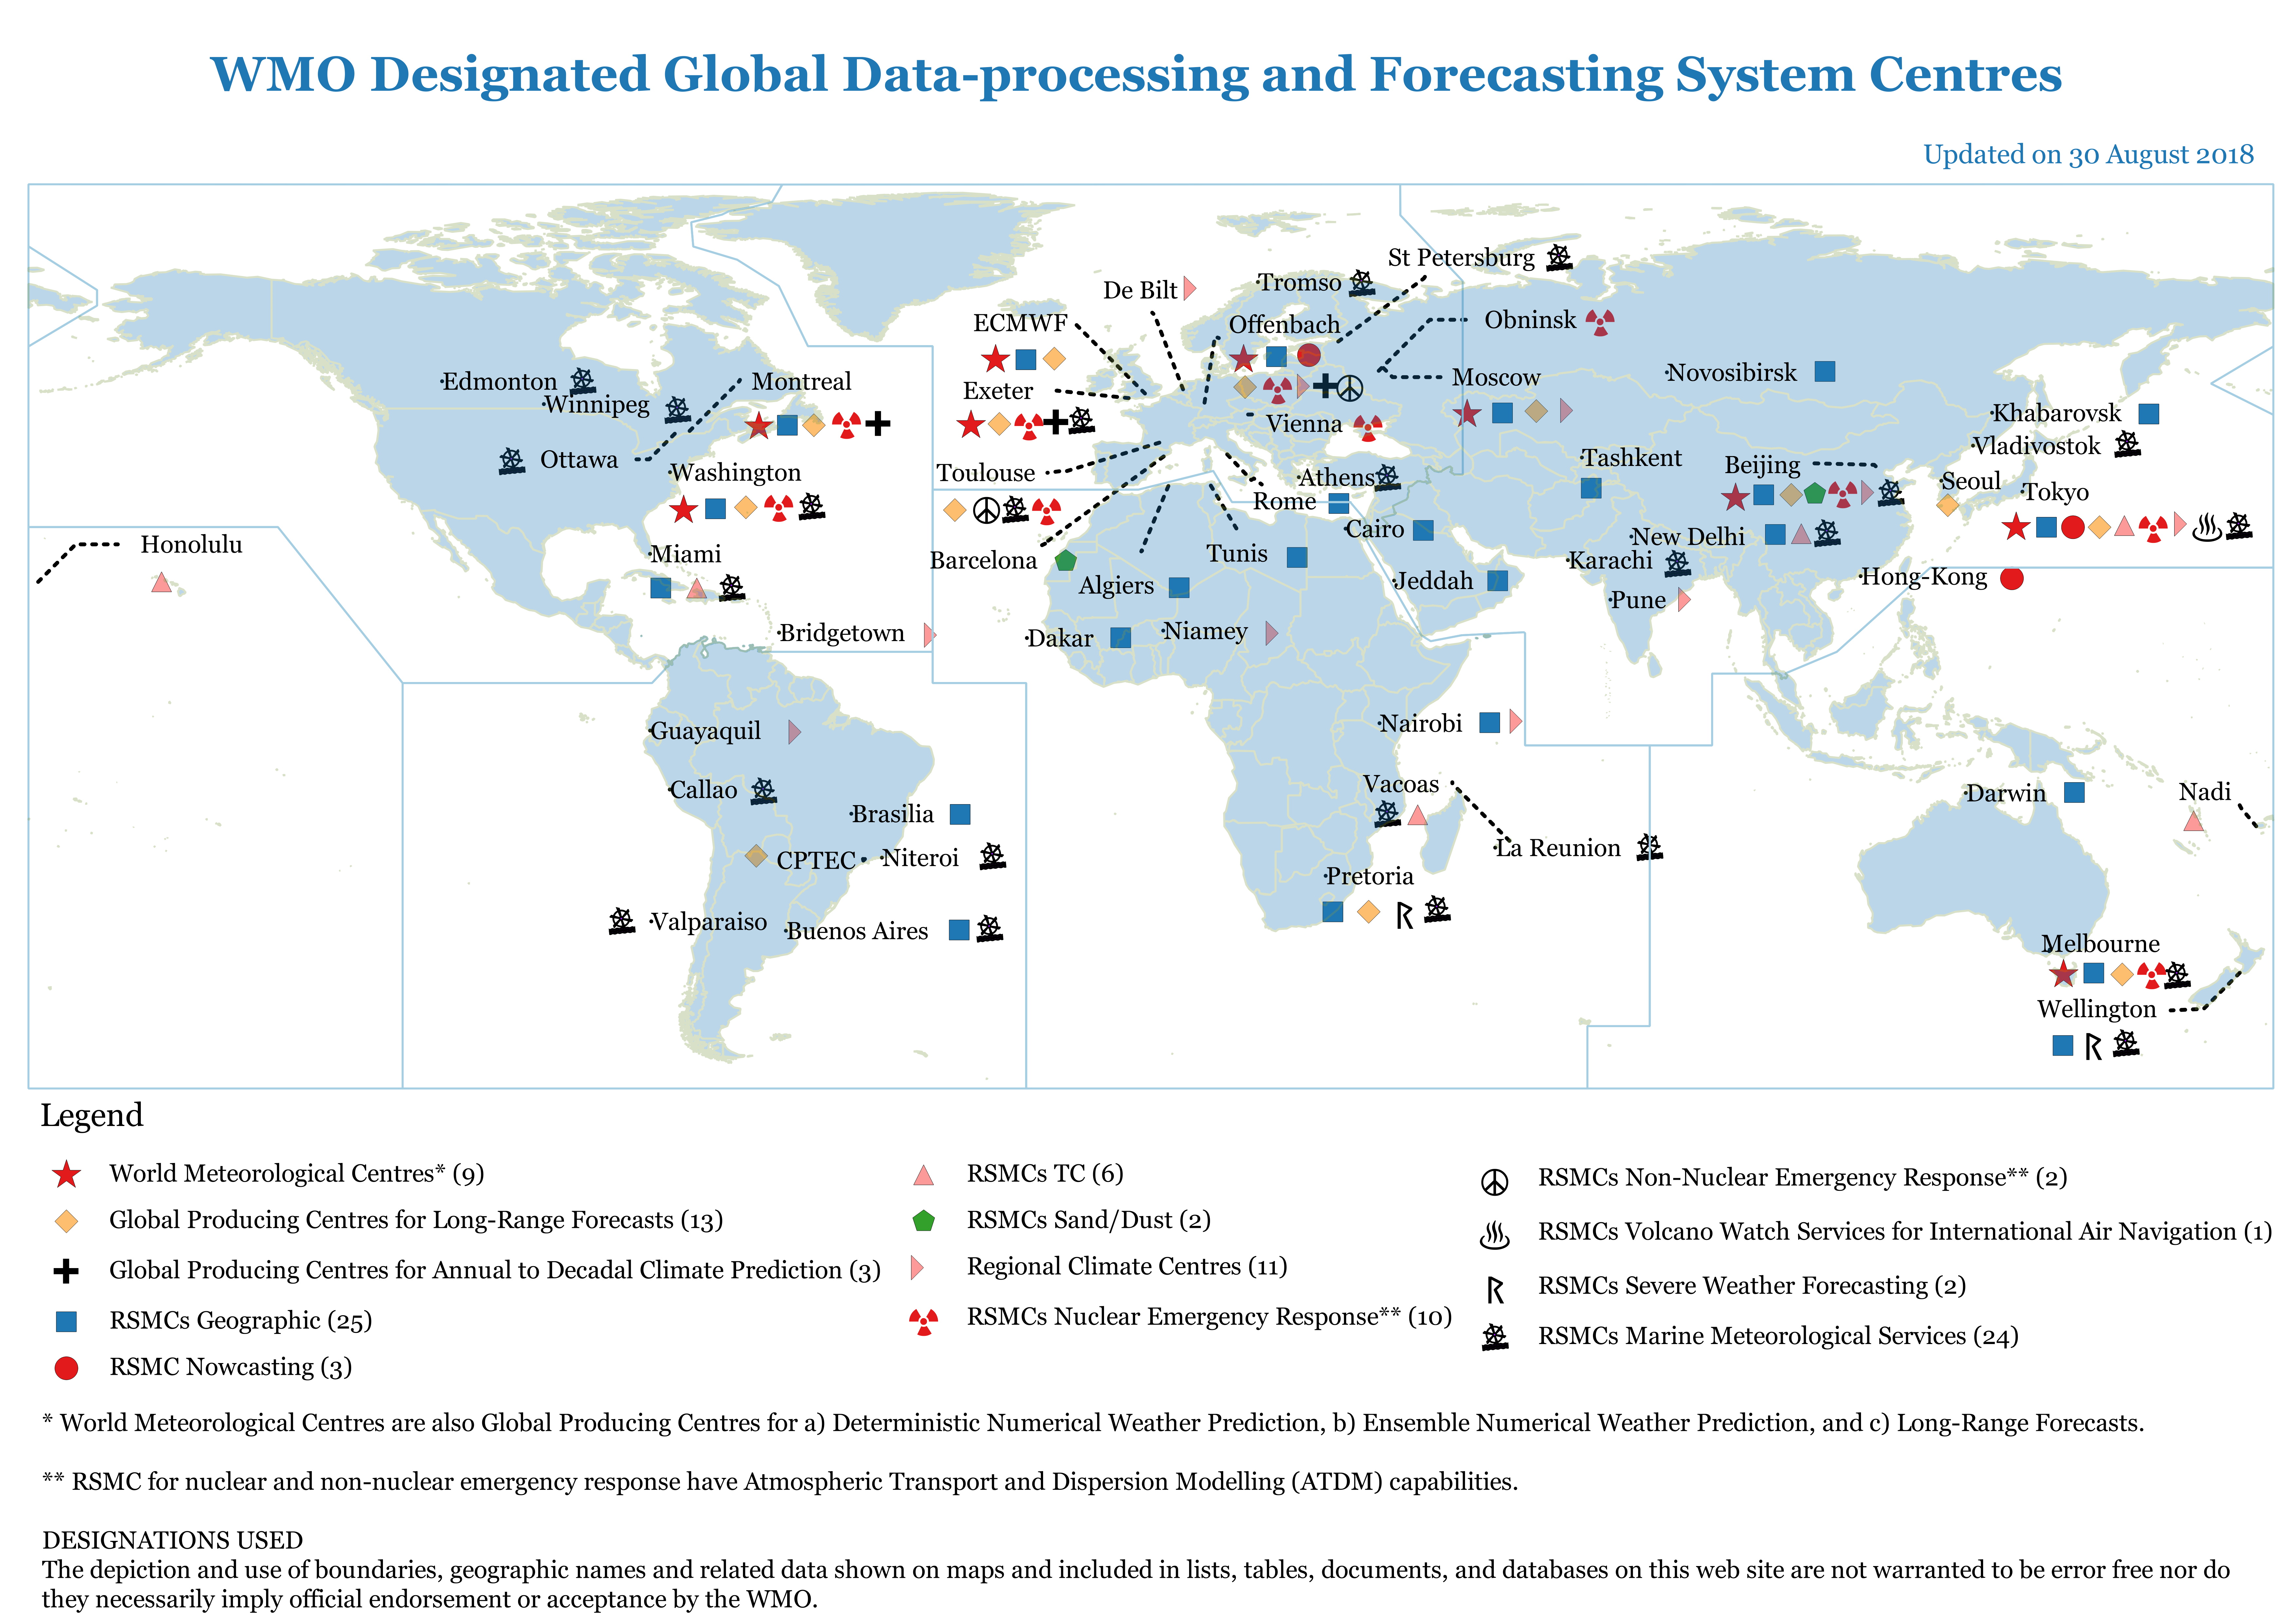
World Weather Watch
Global Telecommunication System
Global Observing System
Global Data Processing and Forecasting System

Slide 3
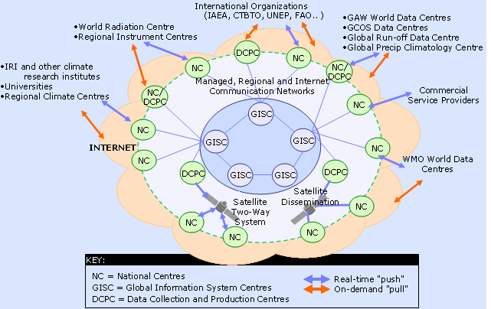
World Weather Watch
WMO Information System
Global Observing System
Global Data Processing and Forecasting System

Slide 4
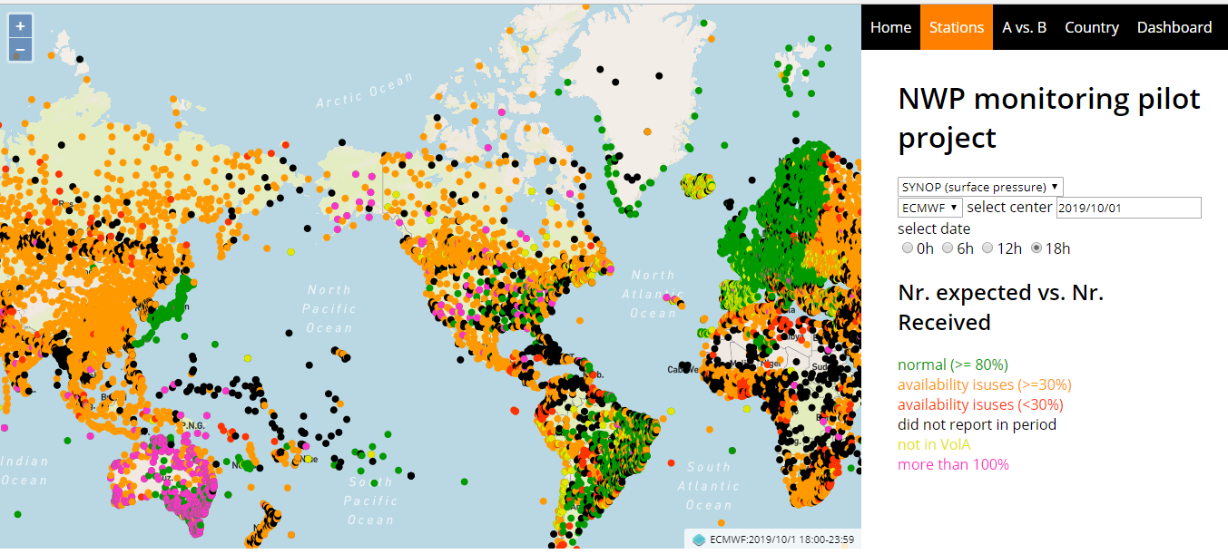
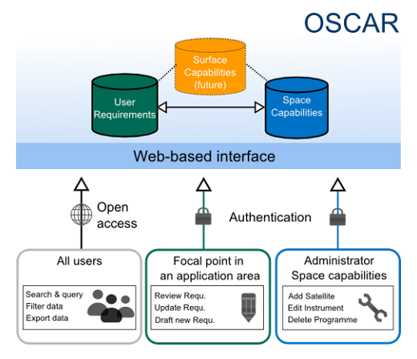
World Weather Watch
WMO Information System
WMO Integrated Global Observing System
Global Data Processing and Forecasting System

Slide 5
World Weather Watch
WMO Information System
WMO Integrated Global Observing System
Seamless Global Data Processing and Forecasting System

Slide 6
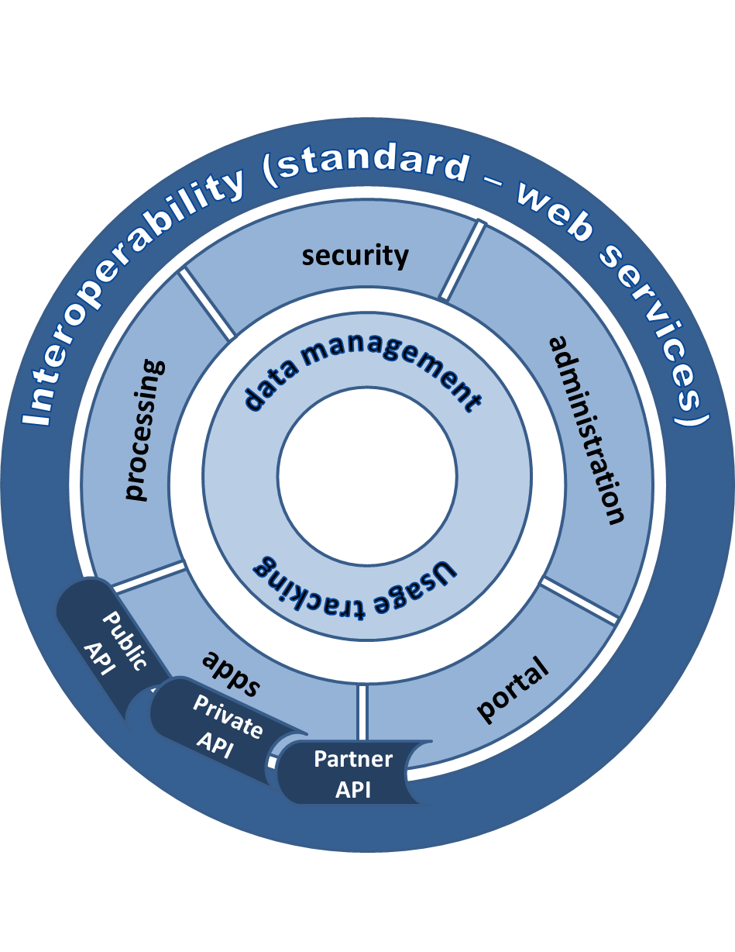
World Weather Watch
WMO Information System 2.0
WMO Integrated Global Observing System
Seamless Global Data Processing and Forecasting System

Slide 7
WIGOS Tools Observing System Capability Analysis and Review

Slide 8
WIGOS Tools WIGOS Data Quality Monitoring System

Slide 9
WIGOS components
GOS
GAW
WHOS
GCW
Co-sponsored
GOOS
GCOS
GTOS

Slide 10
WIS core components

Slide 11
WIS 2.0 vision:
“
WIS 2.0 is a collaborative system of systems using Web-architecture and open standards to provide simple, timely and seamless sharing of trusted weather, water and climate data and information through services.”

Slide 12
WIS 2.0 Implementation
2019
2020
2021
2022
2023
2024
Approach endorsed by Cg
Final approval by EC
Experimental implementation
Technical regulation approved
Initial operating capability

Slide 13
WIS 2.0 Implementation approach
11 Principles providing a technical framework
Recognition that WIS 2.0 is heavily dependent on industry.
Workshop on Future Technology (19-20 March) to align the framework with the industry plans.

Slide 14




WIS 2.0 Principles
WIS 2.0: adopts Web technologies and leverages industry best practices and open standards
Notes:
BENEFIT: Use of widely adopted practices and open standards will enable a large population of users to conveniently interact with WIS 2.0 to discover, access, and use authoritative weather, water and climate data.

Slide 15
WIS 2.0 Principles
WIS 2.0: uses Uniform Resource Locators (URL) to identify resources.
Notes:
BENEFIT: URLs uniquely identify a resource and describe the primary mechanism for retrieving or interacting with it (i.e. the network 'location' and the communications protocol to be used).

Slide 16

WIS 2.0 Principles
WIS 2.0: prioritizes use of public telecommunications networks (i.e. Internet) when publishing digital resources .
Notes:
BENEFIT: Publishing digital resources on the Internet enables the meteorological community to retrieve or interact with those resources - it is unlikely that most of the community would be permitted to join managed networks such as Area Meteorological Data Communications Networks (AMDCN) employed by NMHS for data exchange with guaranteed service levels.
BENEFIT: Internet connections are significantly cheaper than the same bandwidth delivered through a managed networks.

Slide 17
WIS 2.0 Principles
WIS 2.0: requires provision of Web services / APIs to access or interact with digital resources published using WIS.
User
Service provider
BIND
Notes:
BENEFIT: Web services support 'machine-actionability' (i.e. the capacity of software systems to access, interoperate, and reuse data with little or no human intervention) because humans increasingly rely on computational support to deal with data as a result of increase in volume, complexity and velocity (i.e. creation speed) of data.
BENEFIT: NMHSs develop their capacity to build and operate Web services, allowing them to extract more value from their data holdings through delivery of higher value services to their users.

Slide 18

WIS 2.0 Principles
WIS 2.0: encourages NCs and DCPCs to provide 'data reduction' services via WIS that process 'big data' to create results or products that are small enough to be conveniently downloaded and used by those with minimal technical infrastructure.
Notes:
BENEFIT: Using ‘data reduction’ Web services to process high volume, complex data remotely, Members’ agencies and institutions can deliver high-value, high-quality services to their governments and citizens helping them more effectively meet their national mandates without the need to invest in and operate their own data management infrastructure .

Slide 19


WIS 2.0 Principles
WIS 2.0: will add open standard messaging protocols that use the publish-subscribe message pattern to the list of data exchange mechanisms approved for use within WIS and GTS.
Producer 1
User 1
AMQP, MQTT …
Producer 2
User 2
Broker
User 3
Producer 3
User 4
Producer 4
Notes:
BENEFIT: Low effort for data providers to distribute data in real-time to large numbers of consumers.
Advanced Message Queuing Protocol
Message Queuing Telemetry Transport

Slide 20
WIS 2.0 Principles
WIS 2.0: will require all services that provide real-time distribution of messages (containing data or notifications about data availability) to cache/store the messages for a minimum of 24-hours, and allow users to request cached messages for download.
WIS 2.0: will adopt direct data-exchange between provider and consumer.
Notes:
BENEFIT: Software systems that consume real-time data or notifications can recover from failure by requesting delivery of messages that were missed while the system was offline.

Slide 21

WIS 2.0 Principles
WIS 2.0: will phase out use of routeing tables and bulletin headers.
T1T2 A1A2 ii CaCaCaCa YYGGgg CCCC
Notes:
BENEFIT: Simplified message switching operations for all Members because routeing table maintenance no longer required.
BENEFIT: Faster setup of new data-sharing arrangements as there is no need to wait for intermediate nodes to update their routeing table configuration.

Slide 22
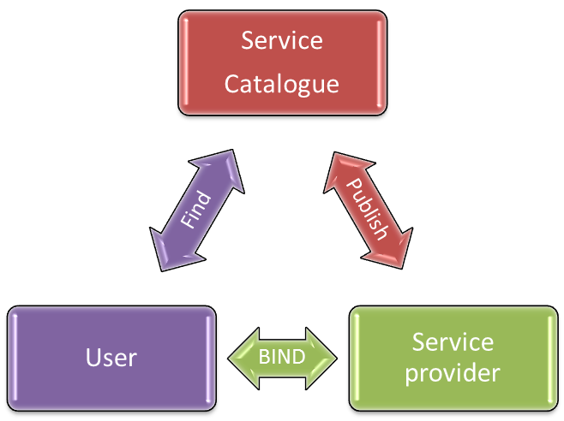
WIS 2.0 Principles
WIS 2.0: will provide a Catalogue containing metadata that describes both data and the service(s) provided to access that data.
Notes:
BENEFIT: Users will be able to easily find the data in WIS that interests them, locate the most convenient Web service with which to access that data, and determine how to best use that Web service to meet their needs.

Slide 23

Thank you
Merci

